Slide 1
Dog Breed Prediciton using Deep Learning
Saksham Chaudhary 21BCE1082

Slide 2

Problem Statement
The goal of this project is to classify images of dogs into their respective breeds. With over 120 breeds to distinguish from, this is a multi-class image classification problem. The problem is inspired by real-world applications where image classification plays a key role, such as in self-driving cars or platforms like Airbnb for automatic image labeling.

Slide 3
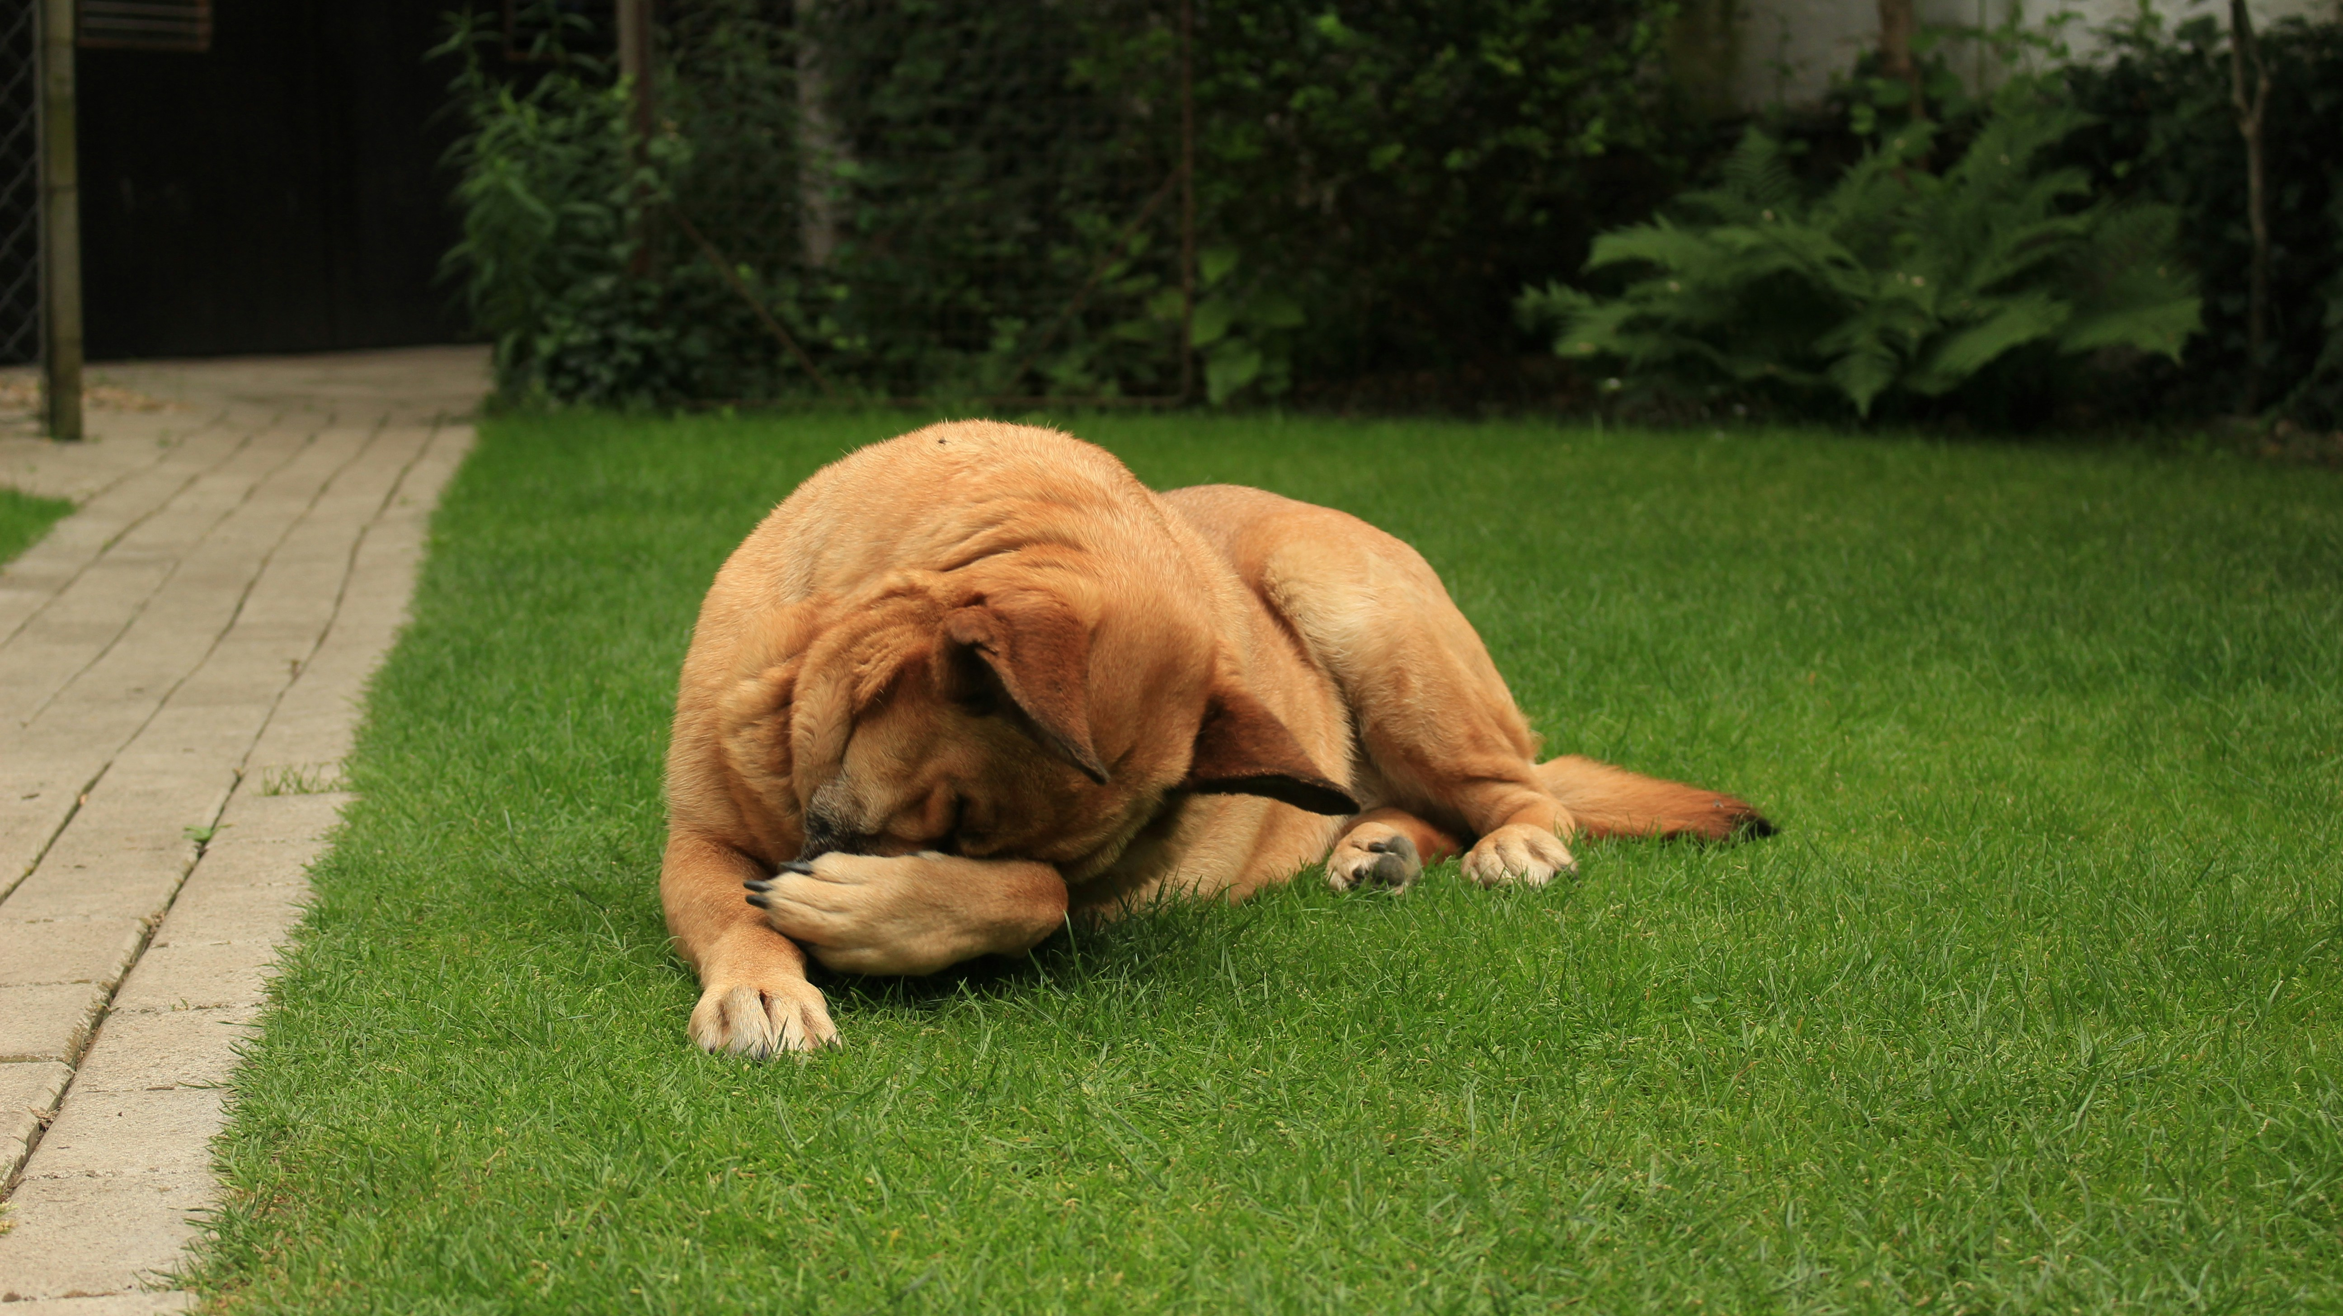
Abstract
This project demonstrates how transfer learning, a machine learning technique, can be applied to classify different breeds of dogs from images. The dataset consists of over 10,000 labeled images of 120 breeds. By leveraging TensorFlow and pre-trained models, the project aims to achieve efficient classification with limited computational resources and training data. The project walks through the machine learning workflow, including data preparation, model training, evaluation, and improvement.

Slide 4
Methodology
Data Collection
01
Data Prepration
02
Model Selection
03
The dataset contains over 10,000 images of dogs, labeled with one of 120 breeds.
The images are preprocessed, resized, and augmented to increase the training set's diversity and improve the model’s robustness.
Pre-trained models like InceptionV3 and EfficientNet are used from TensorFlow Hub. Transfer learning is applied by fine-tuning these models for dog breed classification.
Training
04
Evaluation
05
Improvement
06
The model is trained with the dataset, and techniques such as EarlyStopping are used to prevent overfitting.
The model is evaluated based on accuracy and loss metrics, and its performance is validated using a test set.
Various hyperparameters, such as learning rates, batch sizes, and augmentation techniques, are tuned to improve the model.

Slide 5
Introduction
Classifying images into categories has a wide range of applications, from autonomous vehicles to medical imaging. In this project, we focus on the task of classifying dog breeds from images. Manual identification of dog breeds can be error-prone, especially for mixed or rare breeds. Therefore, we use machine learning techniques, specifically transfer learning, to improve the accuracy of classification. Transfer learning involves using pre-trained models to save time and computational power, making it an ideal choice for this problem.

Slide 6
Software Engineering Priciples Used

Slide 7
Object Oriented Programming
The use of OOP concepts is evident throughout the project, especially through TensorFlow’s model and data pipeline design.
Key principles include:
Encapsulation: Functions and classes hide the complexity of data loading, augmentation, and model training. For instance, TensorFlow’s ImageDataGenerator and Model classes encapsulate lower-level details.
Abstraction: Abstracting away low-level operations (e.g., matrix operations, gradient calculations) so that higher-level operations like model fitting and evaluation are easy to manage.
Inheritance: Transfer learning leverages inheritance by reusing pre-trained models (e.g., InceptionV3), which are inherited and fine-tuned for the specific dog breed classification task.
Polymorphism: Different models (e.g., EfficientNet, InceptionV3) can be used interchangeably within the same training framework without modifying the overall structure of the code, thanks to TensorFlow’s modular design.

Slide 8
Modular Design:
The entire pipeline is divided into clear, reusable modules:.
Data Loading: A dedicated module for importing and preprocessing the data. Functions for loading and augmenting data are implemented separately, allowing for easy reuse.
Model Architecture: The model-building phase is modular, allowing different models to be swapped and experimented with without changing other parts of the pipeline.
Training and Evaluation: Training, evaluation, and hyperparameter tuning are separated into distinct blocks to maintain clarity and ease of experimentation.

Slide 9
Use of Software Models:
Waterfall Model: This approach is reflected in the initial phases of the project where data collection, preprocessing, and model selection are done sequentially. The next phase is dependent on the success of the previous phase.
Iterative Model: Model improvements (e.g., hyperparameter tuning) are conducted in an iterative manner, where each experiment builds upon the results of the previous iteration.
CRISP-DM (Cross Industry Standard Process for Data Mining): The entire workflow, from understanding the problem to deploying the model, closely aligns with the CRISP-DM methodology, emphasizing continuous refinement based on insights and results.

Slide 10
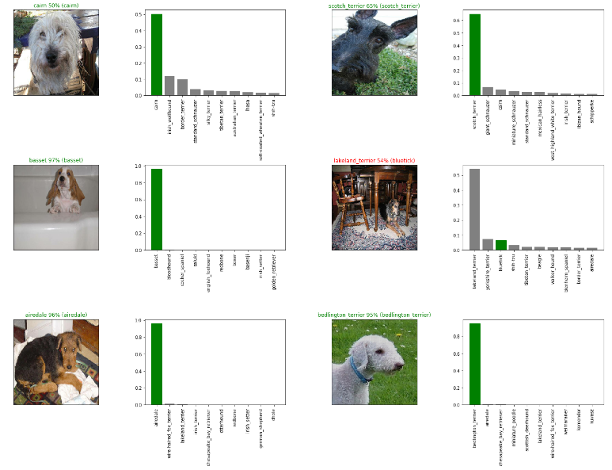
Project Preview

Slide 11
Future Work
To further improve the project, the following can be considered:
Deployment
Turning the trained model into a deployable service, such as a mobile app or web-based classifier, allowing users to identify dog breeds in real-time.
Model Explainbility
Investigating techniques like Grad-CAM to visually explain which parts of the image the model focuses on when predicting the breed.
Lager Dataset
Expanding the dataset to include more images or additional breeds for a more comprehensive classification system.

Slide 12
Thankyou!

